Slide 1
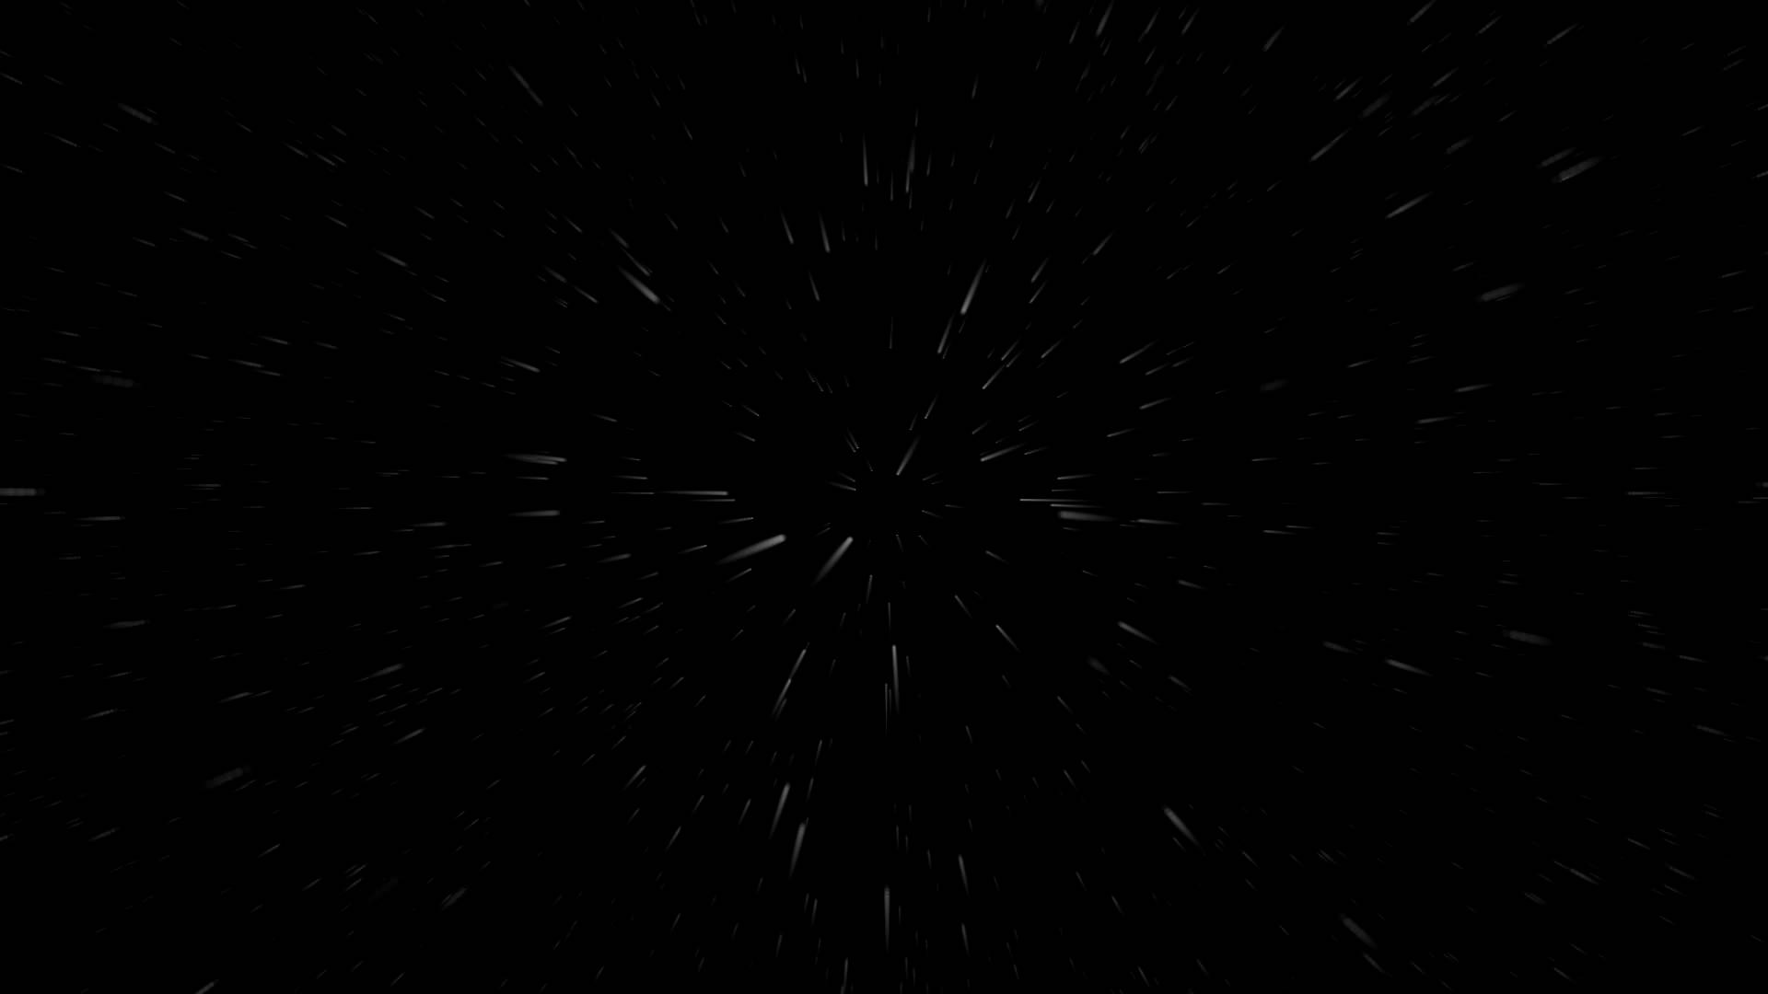
A LONG TIME AGO
IN A GALAXY
FAR FAR AWAY…

Slide 2
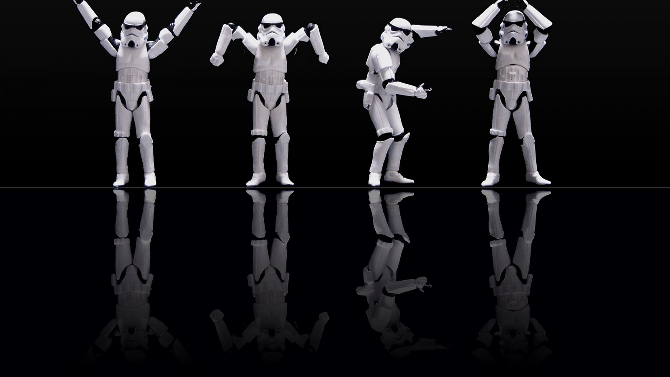
F
E
R
M
I
I N T H E A I R
The minigame sends you far into the hyperspace
(… or more likely back in the 1980s ☺ )
to fight the invading forces of falling bricks of the dark side!

Slide 3


F E R M I
Pavel Ilchev
Falling objects
Major code refactoring to OOP design
T E A M
Ruslan Filipov
Organizing the navigational system
Composed the imperial march
Tomina Petrova
Object collisions
Kostadin Varbanov
Game status on top of screen
Shooting and separate projectiles set
Elitsa Popova
Player and page design
Edward Slavov
To be added
Todor Vasilev
To be added

Slide 4
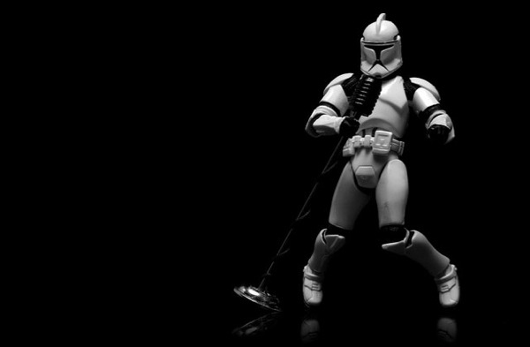
… a brighter day came and here is the product of their united efforts!
Enjoy Your Game !
FERMI in the Air team 2015

